Slide 1
While You Were Sleeping
Elementary S01 E02

Slide 2
Outline
01
Summary of the episode
02
The reason I favor it
03
Activity

Slide 3
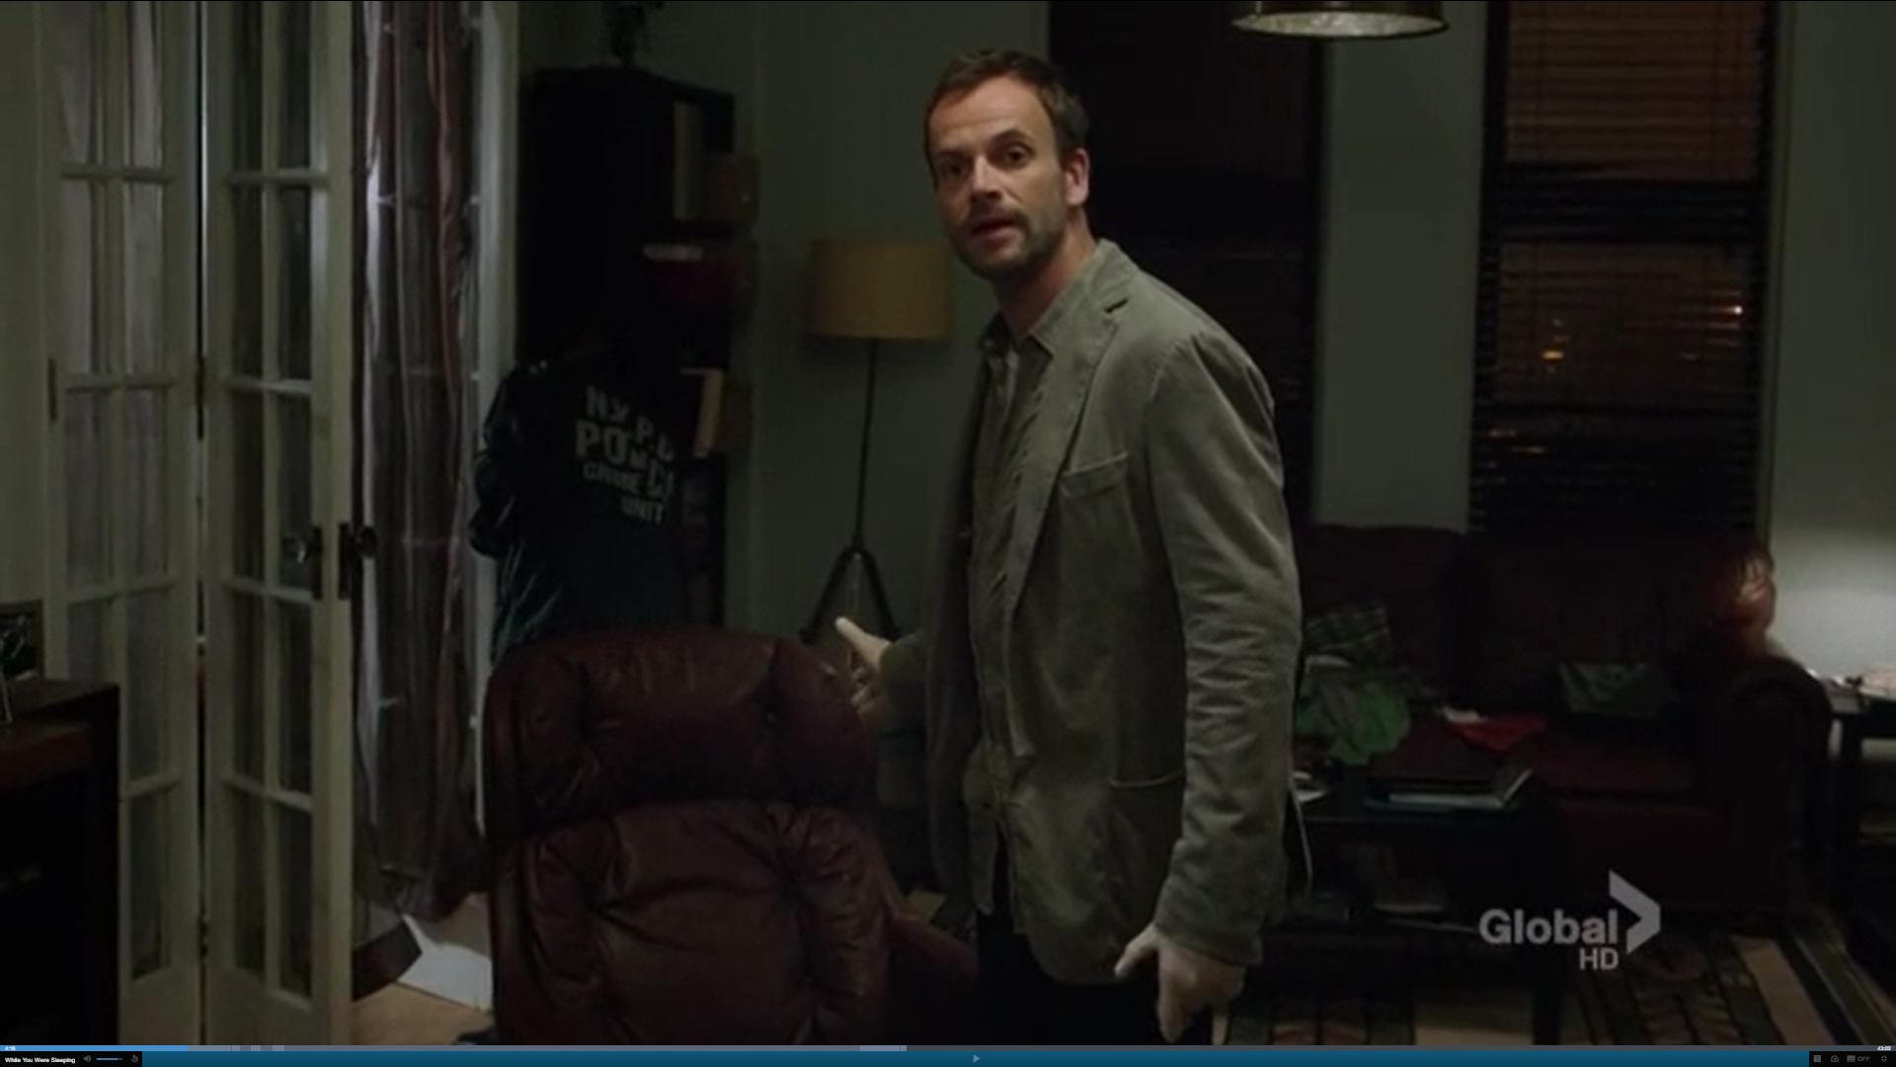
Summary
Victims
Casey McManus
Anna Webster
Similarity
Shot between the eyes
A chair with the smell of deodorant
Rare genetic disorder
Witness
Casey’s neighbor

Slide 4
Charles Ellison
→
→
→
→
Rebecca
Yvette
Casey
Anna

Slide 5
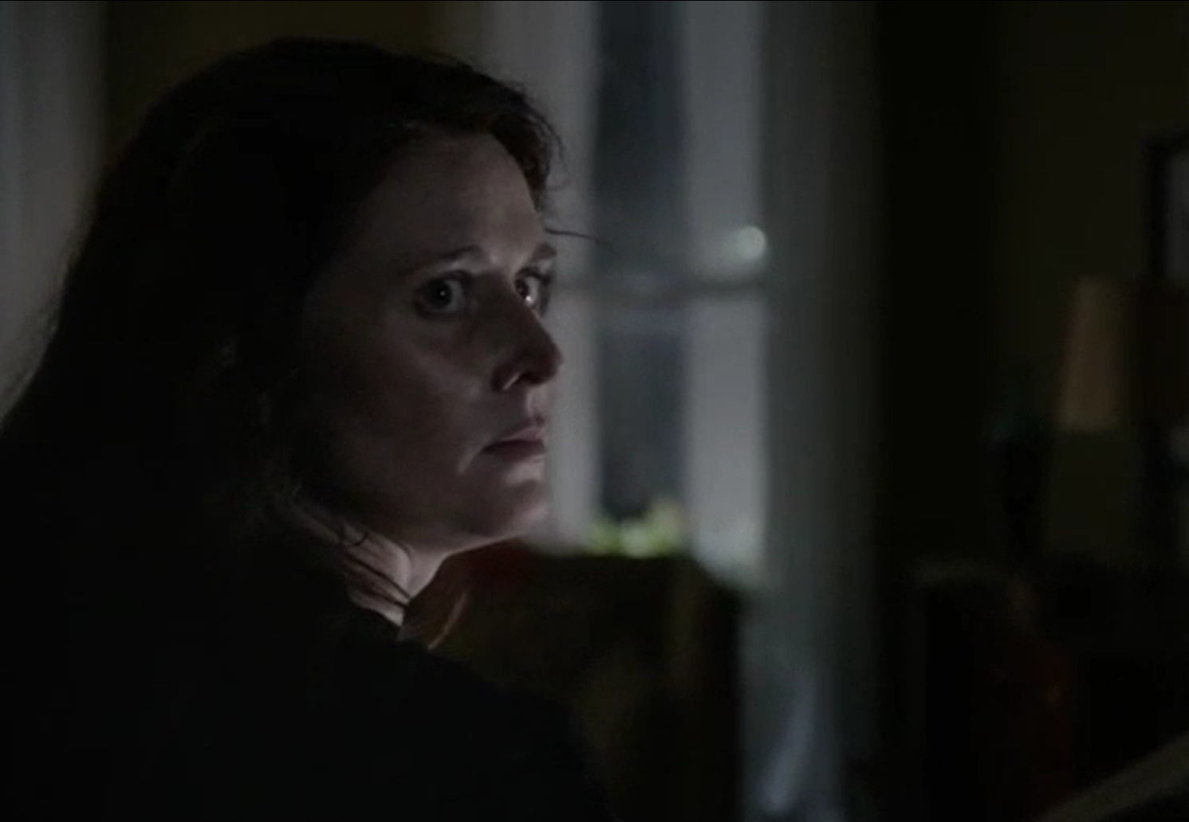
Summary
Sherlock sets a trap
Murderer
Yvette
Medically-induced coma
Weak

Slide 6
The Reason I Like the Episode
Shocking and scary ending
“ Why was she still in a coma today?”
“ Why didn’t Yvette miraculously wake up this morning?”
“ Who did she left to kill?”
“ Perhaps it was someone who stood between her and the entirety of the family fortune.”

Slide 7
Activity: What kind of people you are
Rebecca
Before
Impetuous
Irrational
After
Big-hearted
Tender

Slide 8
Activity: What kind of people you are
Write three words to describe yourself
Write three words to describe your classmate
Share how different you think of yourself & others think of you

